Slide 1




How are you feeling?
I hope you all are feeling GREAT and healthy.
BY: Zeek :)

Slide 2

An illness is a period of being sick
Illnesses are caused by tiny bacteria or viruses that enter our body
They can enter through the mouth, nose, or a wound.

Slide 3


Virus Bacteria
Need another living thing to survive. Transfer from one living thing to another
Can be prevented with Vaccines
Can be found anywhere, can live on their own
We can use antibiotics to fight them

Slide 4
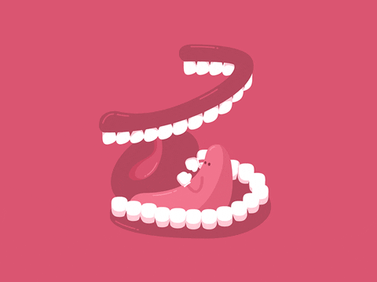
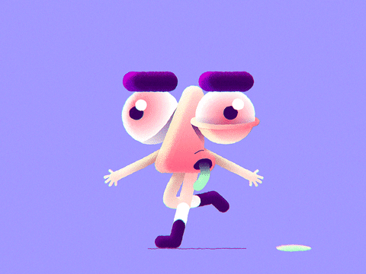

Symptoms indicate that you are ill
Runny Nose Sneezing Sore Throat

Slide 5

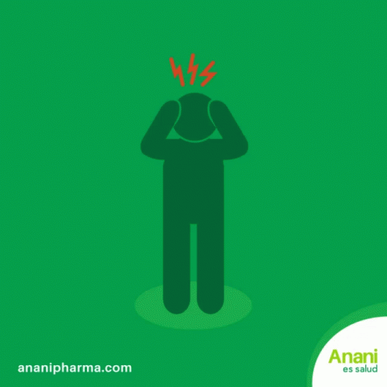
Symptoms indicate that you are ill
OUCH!
My stomach hurts
Fever Body aches or pain

Slide 6
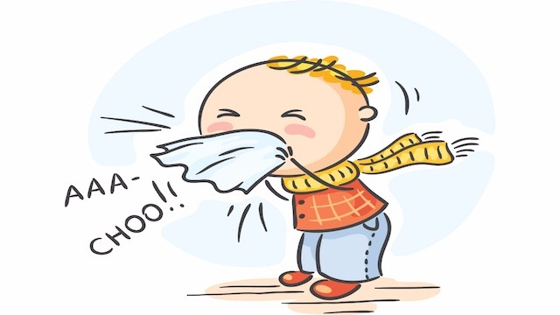
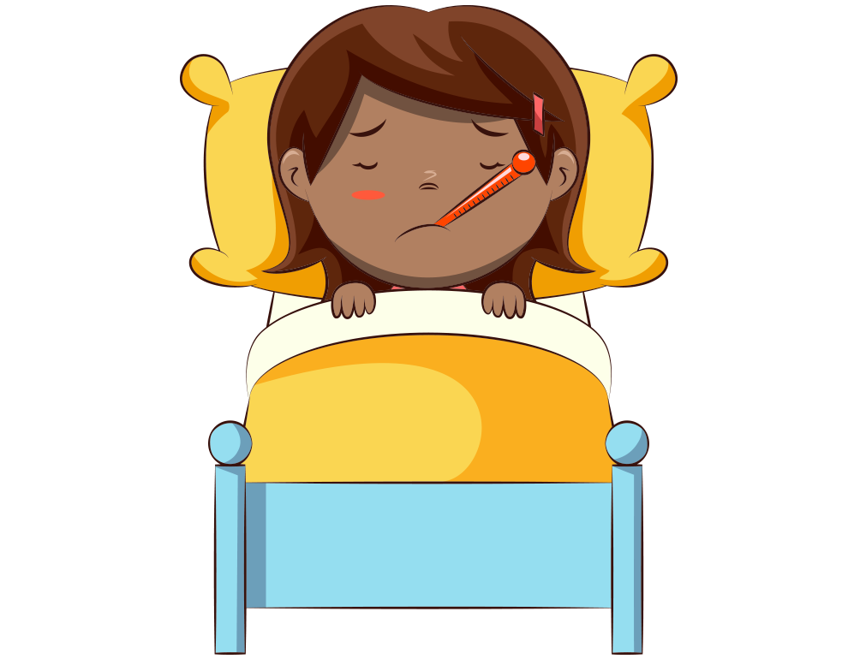
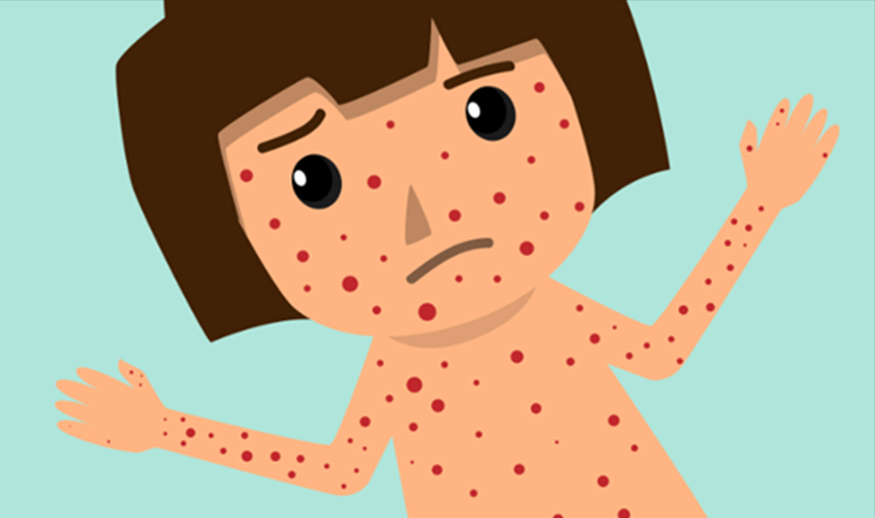
Common illnesses caused by viruses
Common cold- virus, upper respiratory system
The flu- also a virus stronger than the cold. High fever
and strong body aches
Chicken pox- virus, itchy rash, it's contagious

Slide 7
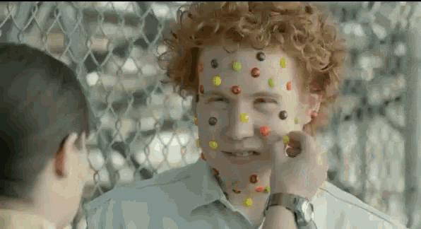
Contagious
Contagious means that the illness spreads from one person to another very easily
Illnesses can be spread through:
-direct contact
-Indirect contact (bacteria left on the door handle
-Through the air

Slide 8

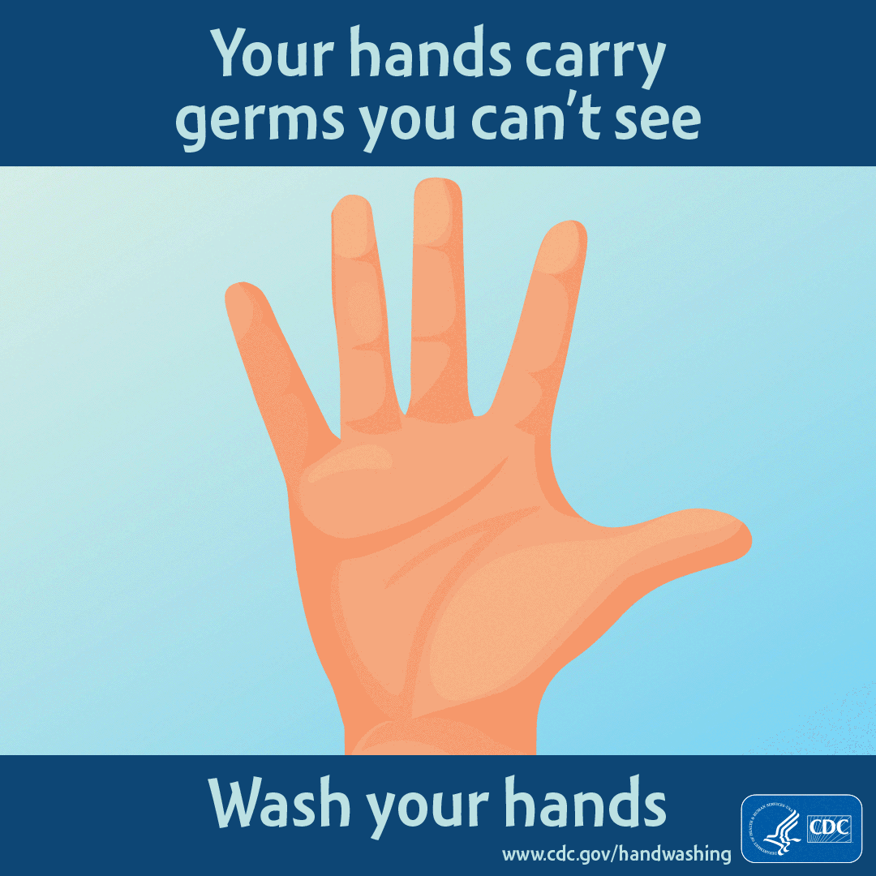
Germs are everywhere and you can't see them, wash your hands!
Try NOT to touch your face and your mouth

Slide 9

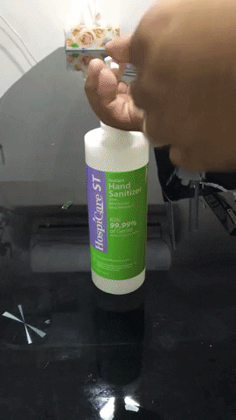
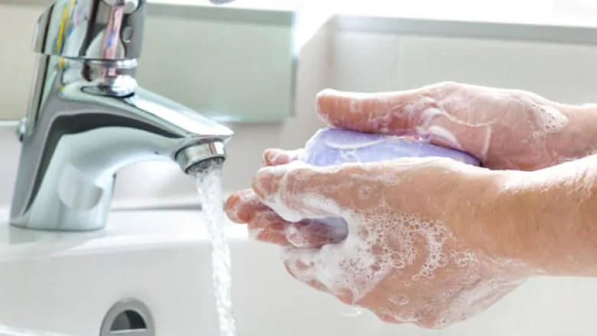
Use disinfecting sprays
Use soap
Use hand sanitizer

Slide 10
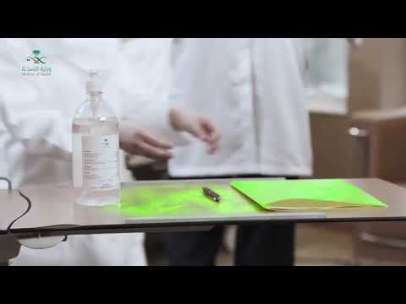
Watch how easily viruses can be spread
And what you can do to prevent it

Slide 11


Medicine helps us get better
Sometimes you may need medicine for a week to recover
Some people need medicine everyday to help their body function

Slide 12
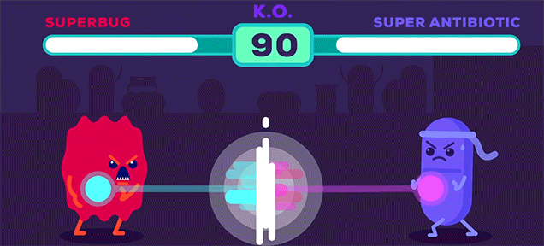
Sometimes we need antibiotics to fight bacterial infections

Slide 13
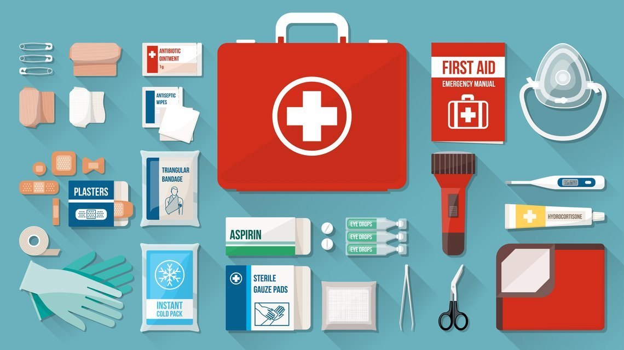

First Aid is the help we can give instantly before being able to see a doctor
If there is an emergency CALL 112

Slide 14

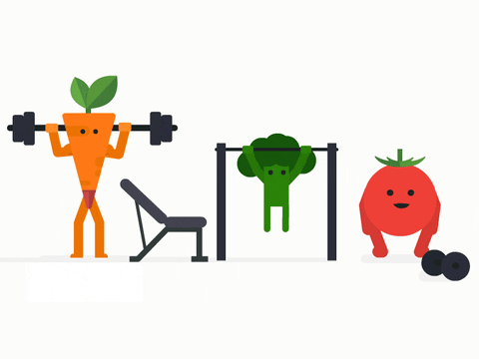
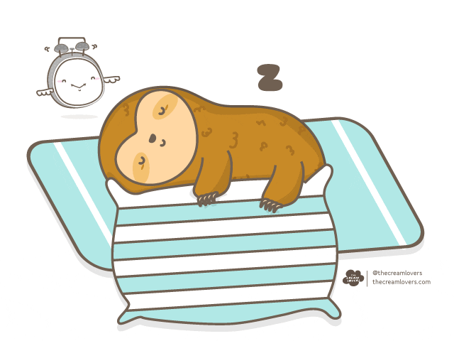
Healthy Habits help fight off illnesses!
Balanced Diet
Exercise
Rest

Slide 15

Our body needs nutrients from foods
A balanced diet means eating foods from all food groups

Slide 16

Carbohydrates
Vitamins and minerals
Protein and iron
Dairy/ Fats
A little bit of sweets

Slide 17
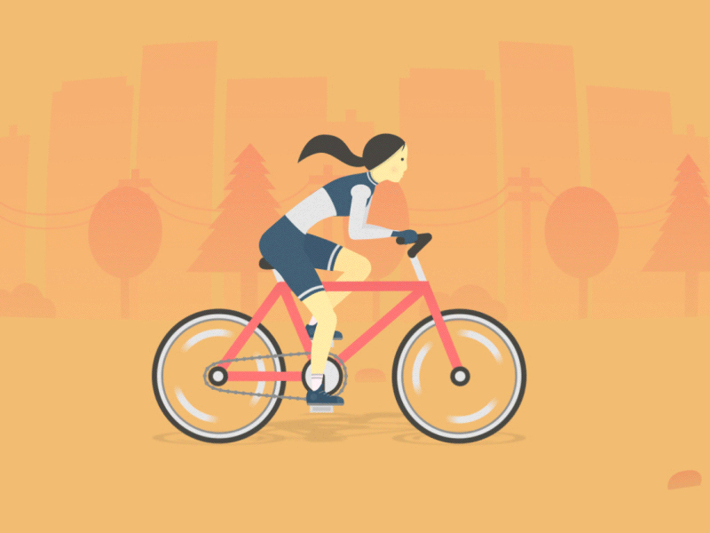
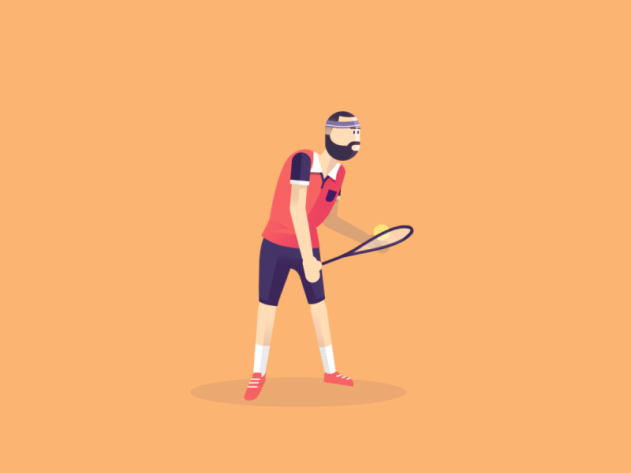

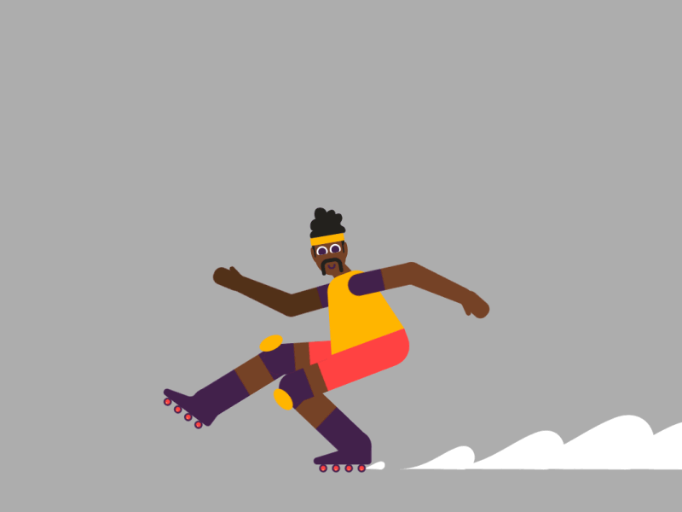
Exercise is very important for all ages!
It is good for your respiratory system, circulatory system and locomotor systems

Slide 18

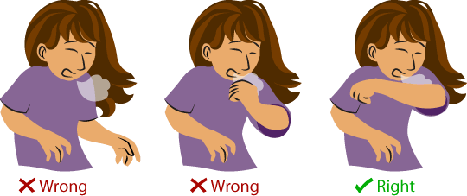
Hygiene
Taking care of your personal hygiene helps fight bacteria
It is very important because we can see the bacteria
Wash your hands!
Cover your mouth when you cough

Slide 19
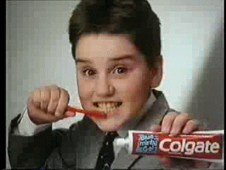

It is also important to
Brush your teeth after eating
Take showers regularly

Slide 20
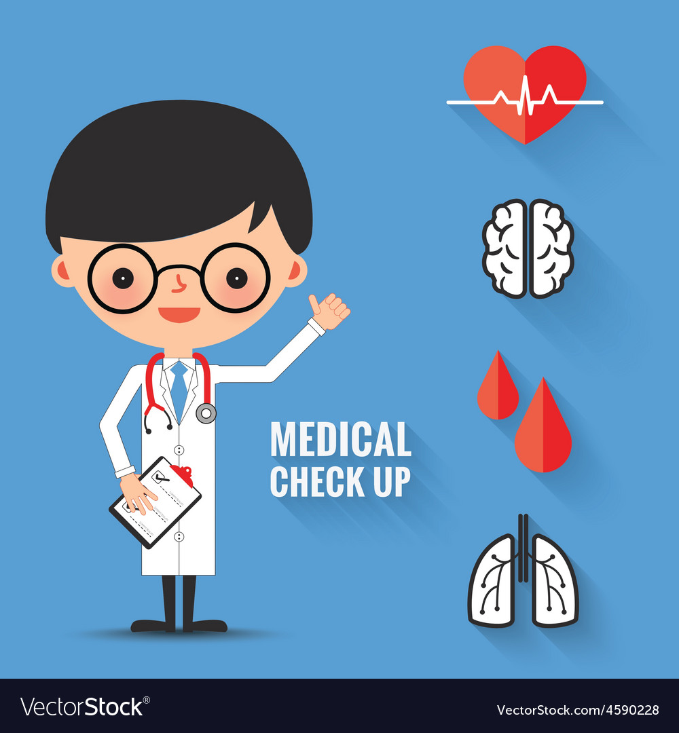
You should also go to the doctor at least once a year to have a CHECK-UP
just to make sure you are healthy
They check your heart rate
They test your brain and eyes
They take your blood pressure
They listen to your lungs

Slide 21

Limit the junk food you eat
Junk food has a lot of:
Salt
Sugar
Bad fats
Too much of these are bad for our heart, and can cause health problems
It is okay to eat junk food sometimes

Slide 22

Do not stay up too late
Go to bed at a normal time
Sleep 10 hours
Have a normal sleep schedule

Slide 23

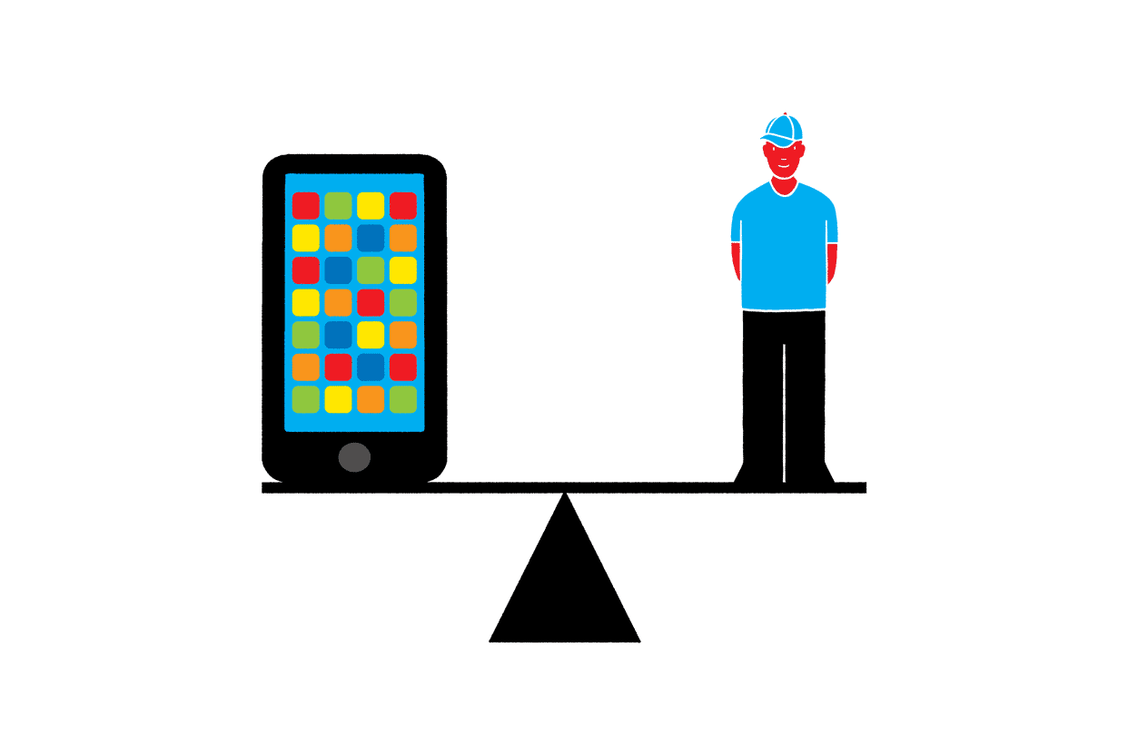
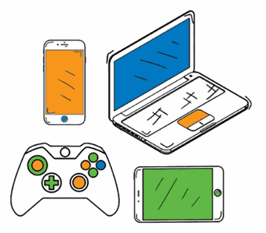
Balance your life
Limit your time with electronics
Your eyes need rest too

Slide 24

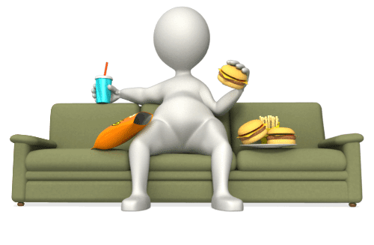
Don´t be a couch potato!!!

